Slide 1


Slide 2
Insertion-Sort
Best-Case Performance: O(n) comparisons, O(1) swaps
Worst-Case Performance: O(n²) comparisons and swaps
Average: O(n²) comparisons and swaps
Space Complexity: O(1) using in-place swaps

Slide 3
Merge-Sort
Best-Case Performance: Ω(n log n)
Worst-Case Performance: 𝛰(n log n)
Average: Θ(n log n)
Space Complexity: O(n) using O(n) auxiliary

Slide 4
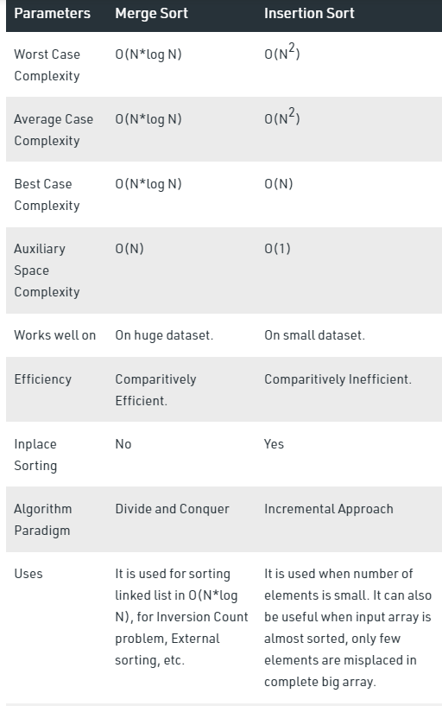
Sourced from Geeksforgeeks
Notes:
https://www.geeksforgeeks.org/merge-sort-vs-insertion-sort/

Slide 5
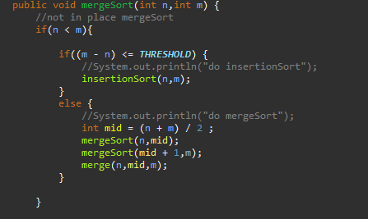
Hybrid Merge-Insertion Sort
Insertion sort is faster than quick sort for smaller arrays as there are less constant-factor overheads such as recursive call,etc…
Solution: After using Merge Sort to recursively divide to sub arrays. If the sub array is less or equal to Some Threshold(S) switch to insertion sort instead, then Sort each sub list recursively by re-applying merge sort and Merge the two sub lists back into one sorted list.

Slide 6
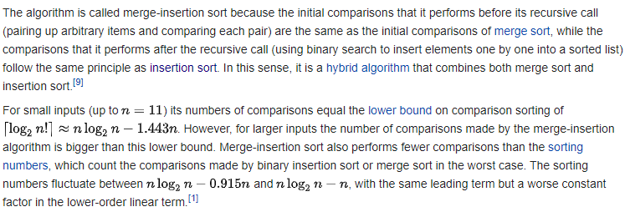
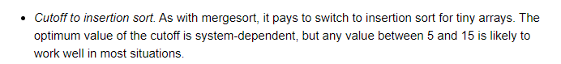
https://en.wikipedia.org/wiki/Merge-insertion_sort
Base on findings online and testing Threshold of S around 10 seems to be good.
https://algs4.cs.princeton.edu/23quicksort/
Notes:
https://en.wikipedia.org/wiki/Merge-insertion_sort
https://algs4.cs.princeton.edu/23quicksort/

Slide 8
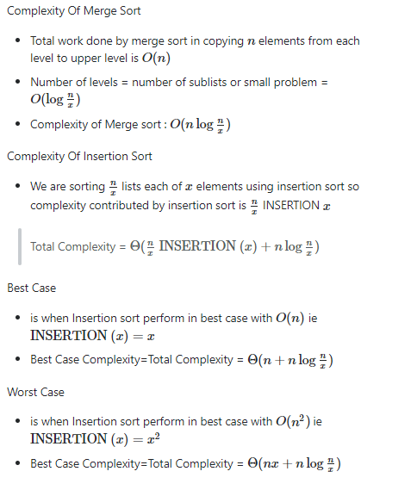
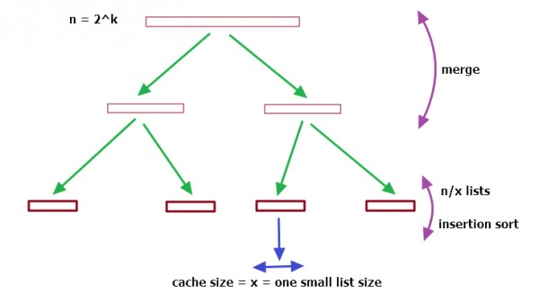
Conclusion: For small array insertion would be prefer less as overhead compared to using merge Sort.
For very huge array hybrid and merge Sort will have similar time taken.
Big-O Notation describes the limiting behavior when n is large, also known as asymptotic behavior.
Cs.stackexchange
Notes:
https://cs.stackexchange.com/questions/68179/combining-merge-sort-and-insertion-sort

Slide 9
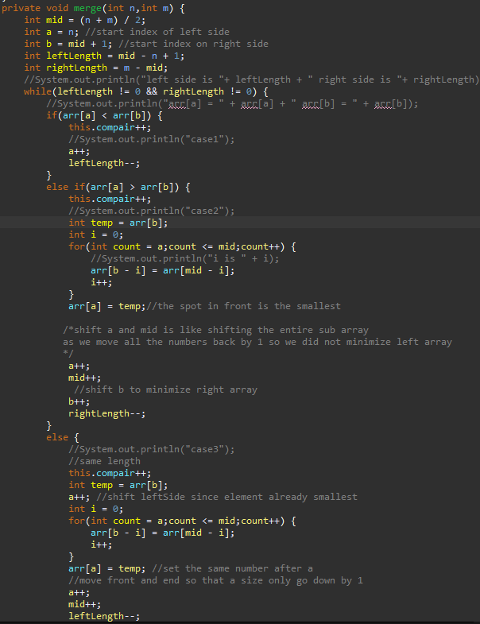
Merge Sort, In place no Auxiliary array
Time Complexity is O(n2 * log(n)) because merge is O(n2). Time complexity of standard merge sort is less, O(n Log n).
In-place merge algorithms can degenerate into O(n²) under certain conditions but is typically O(n.log₂n) in practice.
As in-place Merge Sort Basically needs to read from and write to the same range of the array, and it will overwrite each other.
Case 2 and case 3 of lecture implementation. Need right shifting and swapping then can place smaller number in front
Notes:
https://www.geeksforgeeks.org/in-place-merge-sort/
https://stackoverflow.com/questions/30830707/why-is-the-standard-merge-sort-not-in-place

Slide 10
Summary
Insertion sort
Least time for small array.
Key comparison grows the most when array is huge;
Merge Sort
Time better than insertion sort and in place merge sort for huge array.
Key comparison same as In place Merge sort.
In-place Merge Sort
Time better than insertion sort for huge array but worst than normal Merge sort
Key comparison same as regular Merge Sort
Hybrid using normal Merge Sort
Time will be similar to merge sort when array size if huge.
Hybrid using in-place Merge Sort
Time better than insertion sort for huge array but worst than merge sort and hybrid using normal merge sort
Therefore will have same number of key comparison as normal hybrid but longer time taken.
Summary
Insertion sort best for small array.
Merge Sort and its hybrid is similar for huge array.
In place Merge Sort save memory not using auxiliary array but may have increase in time due to shifting.
Therefore, If size of array was unknown hybrid would be the most efficient overall.

Slide 11
Unused Slides

Slide 12
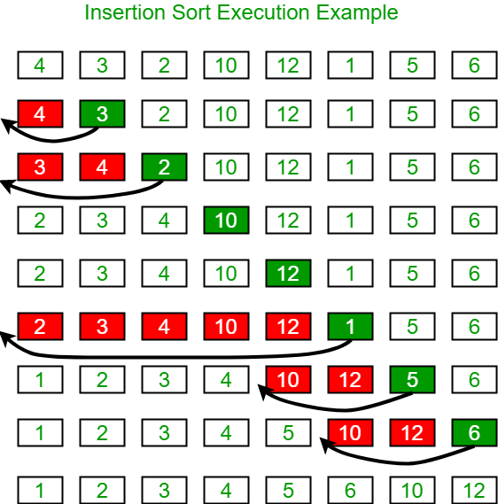
Insertion-Sort
Algorithm
To sort an array of size n in ascending order:
1: Iterate from array[1] to array[n] over the array.
2: Compare the current element (key) to its predecessor.
3: If the key element is smaller than its predecessor, compare it to the elements before. Move the greater elements one position up to make space for the swapped element.
Main idea: Repeatedly pick up an element x to insert into a sorted subarray on the left side, by comparing x with its left neighbor. If they are out of order, swap them; otherwise, insert x there.
Notes:
https://www.geeksforgeeks.org/insertion-sort/

Slide 13
Uses: Insertion sort is used when the number of elements is small. It can also be useful when the input array is almost sorted, only a few elements are misplaced in a complete big array.
Time complexity analysis:
• Best case: (n), when the input array is already sorted.
• Worst case: O(n^2), when the input array is reversely sorted.
• Average case: O(n^2).
Auxiliary Space: O(1),as in place sorting.

Slide 14
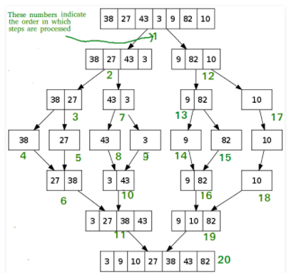
Merge Sort
Algorithm
If the list is of length 0 or 1, then it is already sorted.
Otherwise, divide the unsorted list into two sub lists of about half the size.
Sort each sub list recursively by re-applying merge sort.
Merge the two sub lists back into one sorted list.
Main idea: Merge sort is one of the most efficient sorting algorithms. It works on the principle of Divide and Conquer. Merge sort repeatedly breaks down a list into several sub lists until each sub list consists of a single element and merging those sub lists in a manner that results into a sorted list.
Notes:
https://www.geeksforgeeks.org/insertion-sort/

Slide 15
Uses: Merge Sort is used when the number of elements is large. Will give O(N*log N) for regardless array size sorted/unsorted as recursive use divide and conquer strategy till base case
Time complexity analysis:
• Best case: (n), when the input array is already sorted.
• Worst case: O(n^2), when the input array is reversely sorted.
• Average case: O(n^2).
Space Complexity: Merge sort being recursive takes up the auxiliary space complexity of O(N).
Notes:
https://www.geeksforgeeks.org/merge-sort-vs-insertion-sort/

